Slide 1
Software Architecture
New wine in old bottles?
(i.e., software architecture ≅ global design?,
architect ≅ designer)
Parameswari Ettiappan

Slide 4

What is Software Architecture?
Software Architecture is the global organization of a software system, including
– the division of software into subsystems/components,
– policies according to which these subsystems interact,
– the definition of their interfaces.
T. C. Lethbridge & R. Laganière

Slide 5
What is Software Architecture?
"The software architecture of a program or computing system is the structure or structures of the system, which comprise software components, the externally visible properties of those components, and the relationships among them."
Len Bass

Slide 6
What is Software Architecture?
“fundamental concepts or properties of a system in its environment embodied in its elements, relationships, and in the principles of its design and evolution.”
ISO/IEC/IEEE 42010
http://www.iso-architecture.org/ieee-1471/defining-architecture.html

Slide 7
What is Software Architecture?
A simplified Definition
A software architecture is defined by a configuration of architectural elements--components, connectors, and data--constrained in their relationships in order to achieve a desired set of architectural properties.

Slide 13
Functional Requirements
• Functional requirements specify what the software needs to do. They relate to the actions that the product must carry out in order to satisfy the fundamental reasons for its existence.
• Business Level: defines the objective/goal of the project and the measurable business benefits for doing it.
• User Level: user requirements are written from the user's point-of-view.
• System Level: defines what the system must do to process input and provide the desired output.

Slide 20
Software Quality Model ISO 9126

Slide 21
Capability Maturity Model

Slide 22
Capability Maturity Model

Slide 26
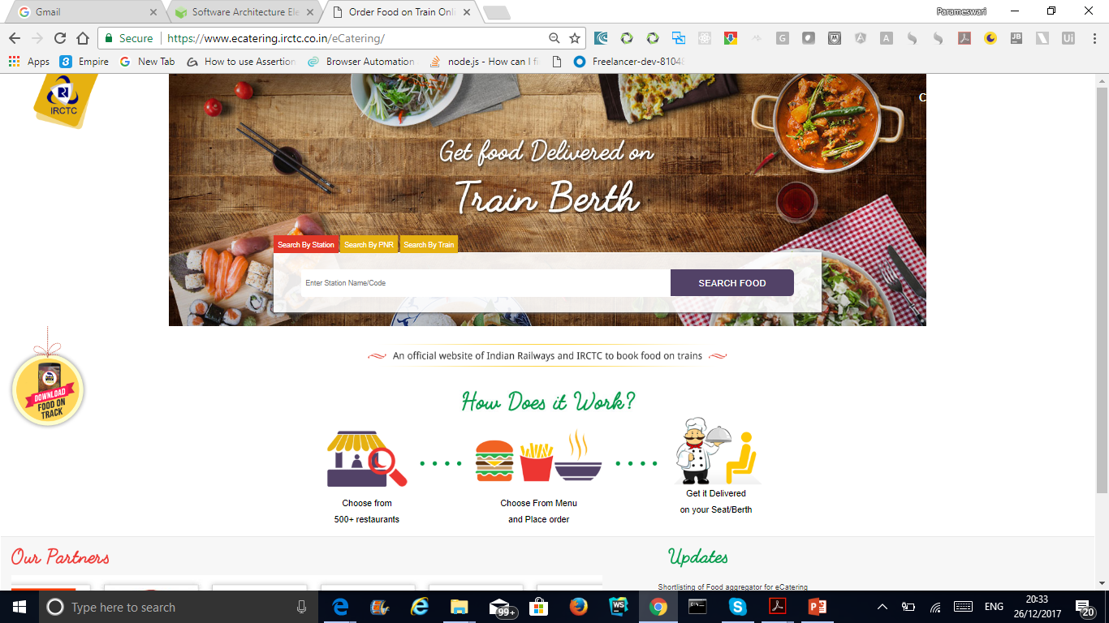
Catering Service

Slide 40
Software Architecture Elements
A component is an abstract unit of software instructions and internal state that provides a transformation of data via its interface
A connector is an abstract mechanism that mediates communication, coordination, or cooperation among components.

Slide 41
Software Architecture Elements
A datum is an element of information that is transferred from a component, or received by a component, via a connector.
A configuration is the structure of architectural relationships among components, connectors, and data during a period of system run-time.
Software Architecture views: Architectures are described using multiple views such as the static view, the dynamic view, and deployment view.
An architectural style is a coordinated set of architectural constraints that restricts the roles/features of architectural elements and the allowed relationships among those elements within any architecture that conforms to that style.

Slide 43
Stakeholder
Definition. A stakeholder in the architecture of a system is an individual, team, organization, or classes thereof, having an interest in the realization of the system.

Slide 44
Stakeholder
The architect must ensure that there is adequate stakeholder representation across the board, including nontechnology stakeholders (such as acquirers and users) and technology-focused ones (such as developers, system administrators, and maintainers).

Slide 45
Stakeholder
Acquirers | Oversee the procurement of the system or product
Assessors | Oversee the system’s conformance to standards and legal regulation
Communicators | Explain the system to other stakeholders via its documentation and training materials
Developers | Construct and deploy the system from specifications (or lead the teams that do this)
Maintainers | Manage the evolution of the system once it is operational
Production Engineers | Design, deploy, and manage the hardware and software environments in which the system will be built, tested, and run
Suppliers | Build and/or supply the hardware, software, or infrastructure on which the system will run
Support Staff | Provide support to users for the product or system when it is running
System Administrators | Run the system once it has been deployed
Testers | Test the system to ensure that it is suitable for use
Users | Define the system’s functionality and ultimately make use of it

Slide 47
The Role of the Architect
Notes:
In a sense, the two elements on the lower left are new: the elements labeled appearance/behaviour, and the one labelled architectural design

Slide 48
Adding architecture, the easy way
stakeholders
(few)
requirements
quality
agreement
architecture
detailed design
development
implementation
Notes:
Iteratie in dit model zit vooral in de requirements, en met slechts een paar stakeholders: onwerpers, opdrachtgever en gebruiker, met name.
Anzelfsprekend is er ook iteratie omdat bv kwaliteitskenmerken niet re realiseren zijn, eea te duur wordt, enz. Maar dat is vaak nadat de overeenkomst gesloten is.

Slide 49
Architecture in the life cycle
stakeholders
(many)
requirements
quality
architecture
agreement
development

Slide 81
Architectural Styles vs. Design Patterns
Many similarities between patterns and styles
Goal: packaged engineering experience
Formulation: organization and interaction among “key” components
But they have come from different communities
Many architectural styles have been well known for a long time in the software engineering community
Patterns are a relatively recent development in OO design
Differences

Slide 82
Characterizing Architectural Styles
Component and Connector characteristics
Allowed configurations
Underlying computational model
Stylistic invariants
Common examples of its use
Advantages and disadvantages
Common specializations
Notes:
State why these are important

Slide 83
The Pipe-and-Filter Style
The primary architectural style supported by UNIX
Components
Individual programs transforming input data to output data
Connectors
Unidirectional or bidirectional data streams
Configurations
Parallel linear composition of program invocations
Underlying computational model
Sequential data flow and transformation
Stylistic invariants
Every component has one input predecessor and one output successor
Common specializations
Pipelines: single linear composition of pipes and filters
Bounded pipes, typed pipes
Notes:
Pipelines: connectors also have single input and output

Slide 84
Pipe-and-Filter Example: UNIX Text Processing
pic
eqn
tbl
troff
lpr
% pic mydoc.t | eqn | tbl | troff | lpr
Legend:
Component
Connector

Slide 85
Pipe-and-Filter Advantages and Disadvantages
Advantages
Simplicity: Simple, intuitive, efficient composition of components
Reusability: High potential for reuse of components
Evolvability: Changing architectures is trivial
Efficiency: Limited amount of concurrency (contrast batch-sequential)
Consistency: All components have the same interfaces, only one type of connector
Distributability: Byte streams can be sent across networks
Disadvantages
Batch-oriented processing
Must agree on lowest-common-denominator data format
Does not guarantee semantics
Limited application domain: stateless data transformation
Notes:
Advantages appreciated by considering sed/awk/grep/sort
Compiler is example where LCD data format needed

Slide 86
The Layered System Style
Components
Programs or subprograms
Connectors
Procedure calls or system calls
Configurations
“Onion” or “stovepipe” structure, possibly replicated
Underlying computational model
Procedure call/return
Stylistic invariants
Each layer provides a service only to the immediate layer “above” (at the next higher level of abstraction) and uses the service only of the immediate layer “below” (at the next lower level of abstraction)

Slide 87
Layered Virtual Machine Example: Java
Java
Java
Operating
Java Virtual Machine
Processor
(Virtual Machine Style)
System
Virtual Machine
Application

Slide 88
Layered System Example: OSI Protocol Stack
Application
Application
Presentation
Presentation
Session
Session
Transport
Transport
Network
Network
Network
Network
Data Link
Data Link
Data Link
Data Link
Physical
Physical
Physical
Physical

Slide 89
Layered System Advantages and Disadvantages
Advantages
Decomposability: Effective separation of concerns
Maintainability: Changes that do not affect layer interfaces are easy to make
Evolvability: Potential for adding layers
Adaptability/Portability: Can replace inner layers as long as interfaces remain the same (consider swapping out a Solaris JVM for a Linux one)
Understandability: Strict set of dependencies allow you to ignore outer layers
Disadvantages
Performance degrades with too many layers
Can be difficult to cleanly assign functionality to the “right” layer

Slide 90
The Blackboard Style
Components
Blackboard client programs
Connector
Blackboard: shared data repository, possibly with finite capacity
Configurations
Multiple clients sharing single blackboard
Underlying computational model
Synchronized, shared data transactions, with control driven entirely by blackboard state
Stylistic invariants
All clients see all transactions in the same order

Slide 91
Blackboard Example: A Chat Room
Chat Participant
Chat Participant
Chat Participant
Chat Transcript
Chat Participant
Chat Participant

Slide 92
Blackboard Advantages and Disadvantages
Advantages
Simplicity: Only one connector (the blackboard) that everyone uses
Evolvability: New types of components can be added easily
Reliability(?): Concurrency controls of information, traditionally a tricky problem, can be largely addressed in the blackboard
Disadvantages
Blackboard becomes a bottleneck with too many clients
Implicit “partitions” of information on the blackboard may cause confusion, reduce understandability

Slide 93
The Hypertext Style
Components
“Documents” and document parts
Connectors
Unidirectional hyperlinks between document parts
Configurations
Arbitrary topology of linked documents
Underlying computational model
Bidirectional hyperlink traversal
Stylistic invariants
Adherence to standardized document formats
Notes:
This is a data-oriented style, idea is 30+ years old (Engelbart)

Slide 94
Hypertext Example: The World Wide Web
HTML Document
Java Applet
HTML Document
GIF Image
Text Document

Slide 95
Hypertext Advantages and Disadvantages
Advantages
Efficiency: Can organize large amounts of non-uniform data
Adaptability: New types of applications and data can be integrated
Distributability: Well-suited to wide-area distributed application
Scalability: Lack of centralization allows millions of clients (cf. the Web)
Flexibility: Few constraints on topology, organization
Disadvantages
Reliability (consider broken links)
Somewhat difficult to maintain context
Need for sophisticated indexing mechanisms
Need for sophisticated version control

Slide 96
Event-Based Systems and the Implicit Invocation Style
Components
Programs or program entities that announce and/or register interest in events
Connectors
Event broadcast and registration infrastructure
Configurations
Implicit dependencies arising from event announcements and registrations
Underlying computational model
1. Event announcement is broadcast
2. Procedures associated with registrations (if any) are invoked
Notes:
Contrast with explicit invocation

Slide 97
Implicit Invocation Example: Program Debugging (1)
Set breakpoint line 10
Debug events
Interactive
Program
Debugger
Application Program
Breakpoint
Routine

Slide 98
Implicit Invocation Example: Program Debugging (2)
Debug events
line 10
Interactive
Program
Debugger
Application Program
Breakpoint
Routine

Slide 99
Implicit Invocation Example: Program Debugging (3)
Line 8 reached
Debug events
line 10
Interactive
Program
Debugger
Application Program
Breakpoint
Routine

Slide 100
Implicit Invocation Example: Program Debugging (4)
Line 10 reached
Debug events
line 10
Interactive
Program
Debugger
Application Program
Breakpoint
Routine
Implicit Invocation!

Slide 101
Implicit Invocation Advantages & Disadvantages
Advantages
Reusability: Components can be put in almost any context
Distributability: Events are independent and can travel across the network
Interoperability: Components may be very heterogeneous
Visibility: Events are a reified form of communication that can be logged and viewed
Robustness: Components in this style generally have to be written to tolerate failure or unexpected circumstances well
Disadvantages
Reliability: Components announcing events have no guarantee of getting a response
Simplicity: Components announcing events have no control over the order of responses, so they must be robust enough to handle this
Understandability: Difficult to reason about the behavior of an announcing component independently of the components that register for its events
Event abstraction does not cleanly lend itself to data exchange

Slide 102
Distributed Peer-to-Peer Systems
Components
Independently developed objects and programs offering public operations or services
Connectors
Remote procedure call (RPC) over computer networks
Configurations
Transient or persistent connections between cooperating components
Underlying computational model
Synchronous or asynchronous invocation of operations or services
Stylistic invariants
Communications are point-to-point

Slide 103
Client/Server Systems
Client/Server systems are the most common specialization (restriction) of the peer-to-peer style
One component is a server offering a service
The other components are clients using the service
Server implementation is transparent but can be centralized or distributed, single-threaded or multi-threaded
Single interface point with physically distributed implementation
Dynamic, transparent selection from among multiple interface points
Notes:
Server is permanent, clients may come and go

Slide 104
Client/Server Example: The World Wide Web
Browser Clients
Web Servers
Netscape
Navigator
HTTP
(asynchronous RPC)
www.ics.uci.edu
Microsoft
IE
Notes:
What happened to hypertext style? Control model vs. data model; multiple views

Slide 105
3-Tier Client/Server Systems
3-Tier Client/Server systems are a common class of distributed business systems
Increasing competition requires business to find new ways of exploiting legacy information assets
First tier: Client (user interface) tier
Second (middle, “business logic”) tier: Servers acting as “business objects”, encapsulating abstract, integrated models of multiple, disparate data sources
Third (back-end, database) tier: Legacy business applications providing data services

Slide 106
3-Tier System Example: Marketing at a TelCo
Client Tier
Server Tier
Legacy Tier
Telemarketing
Agent (CA)
Customer Billing System
Client/ Server Middleware
Customer Loss Analysis
Network Services
Provisioning System
Telemarketing
Agent (NY)
Legacy Wrappers

Slide 107
The Real Peer-to-Peer Apps
Napster
SETI-at-home (well, not really)
Gnutella
Groove
Magi
Web Services

Slide 108
Peer-to-Peer Advantages and Disadvantages
Advantages
Interoperability
A natural high-level architectural style for heterogeneous distributed systems
Understandability: Small number of tiers, similar to layered-system properties
Reusability: Especially with regard to legacy applications
Scalability: Powerful enough server tiers can accommodate many clients
Distributability: Components communicate over a network, generally
Disadvantages
Visibility, Maintainability: Difficult to analyze and debug
Distributed state
Potential for deadlock, starvation, race conditions, service outages
Simplicity: Require sophisticated interoperability mechanisms
Data marshalling and unmarshalling
Proxies and stubs for RPC
Legacy wrappers

Slide 109
Some Criteria for Selecting and Comparing Styles
Control flow
Data flow
Application
Distribution
Scalability
What else?
What other styles can you think of?

